Slide 1
ORIENTATION ORIENTATION ORIENTATION

Slide 2
INTRODUCTION TO DIRECTORATE OF CAREER DEVELOPMENT AND EMPLOYABILITY SERVICES

Slide 5
The Directorate is new. It came on board 2024.
It is a “Career Help Directorate.”
Unemployment among students that graduates from Nigeria Universities necessitate the coming on board of the Directorate.

Slide 6
Mission Statement
-Our mission is to provide comprehensive career development and employability services to All Students, empowering them to achieve their career goals and become valuable contributors to the workforce and also to themselves.
-To Help without discrimination for holistic career development for every students of TSU.

Slide 7
Vision Statement
Our vision is to be a leading Career Development and Employability Services Provider, recognized for excellence in supporting students’ success and employability skills
How?
Through our objectives

Slide 8
Objectives
Our objectives are to:
- Provide career guidance and counselling services to students
- Develop and deliver employability skills training programs
- Facilitate internship and job placement opportunities for students
- Foster partnerships with employers and industry stakeholders
All with the aim of helping our students to succeed.

Slide 9
Services Offered
We offer a range of services, including:
- Setting SMART goals
- Effective Study Habbit
- Career assessments and counselling
- Resume and cover letter writing support
- Interview preparation and practice
- Job search strategies and techniques
- Emotional Intelligence
- Employability skills training programs
- Creative thinking Skills
All geared towards helping the students graduate with employable skills to compete in the job market

Slide 10
Benefits of Using Our Services
By using our services, students can:
- Navigate their Educational Program with ease
- Clarify their career goals and aspirations
- Develop the skills and knowledge needed to succeed in the workforce
- Increase their chances of securing internship, job opportunities and scholarship
- Enhance their employability and career prospects
- And develop relationship skills needed for meaningful development

Slide 11
Meet the University Management Team

Slide 12
PROF. SUNDAY PAUL BAKO
VICE CHANCELLOR
TARABA STATE UNIVERSITY, JALIINGO.

Slide 13
DR. REUBEN JONATHAN
DEPUTY VICE CHANCELLOR ADMIN.
TARABA STATE UNIVERSITY, JALIINGO.

Slide 14
DR. AHMAD BABA MUHAMMAD
DEPUTY VICE CHANCELLOR ACADEMICS AND RESEARCH
TARABA STATE UNIVERSITY, JALIINGO.

Slide 15
PROF. MAHMOOD HAMID UMAR
DEPUTY VICE CHANCELLOR DEVELOPMENTAL SERVICES
TARABA STATE UNIVERSITY, JALIINGO.

Slide 16
DR. JOSEPH UMAR BIBINU
REGISTRAR
TARABA STATE UNIVERSITY, JALIINGO

Slide 17
DR. ABRAHAM A. BAGU
BURSAR
TARABA STATE UNIVERSITY, JALIINGO.

Slide 18
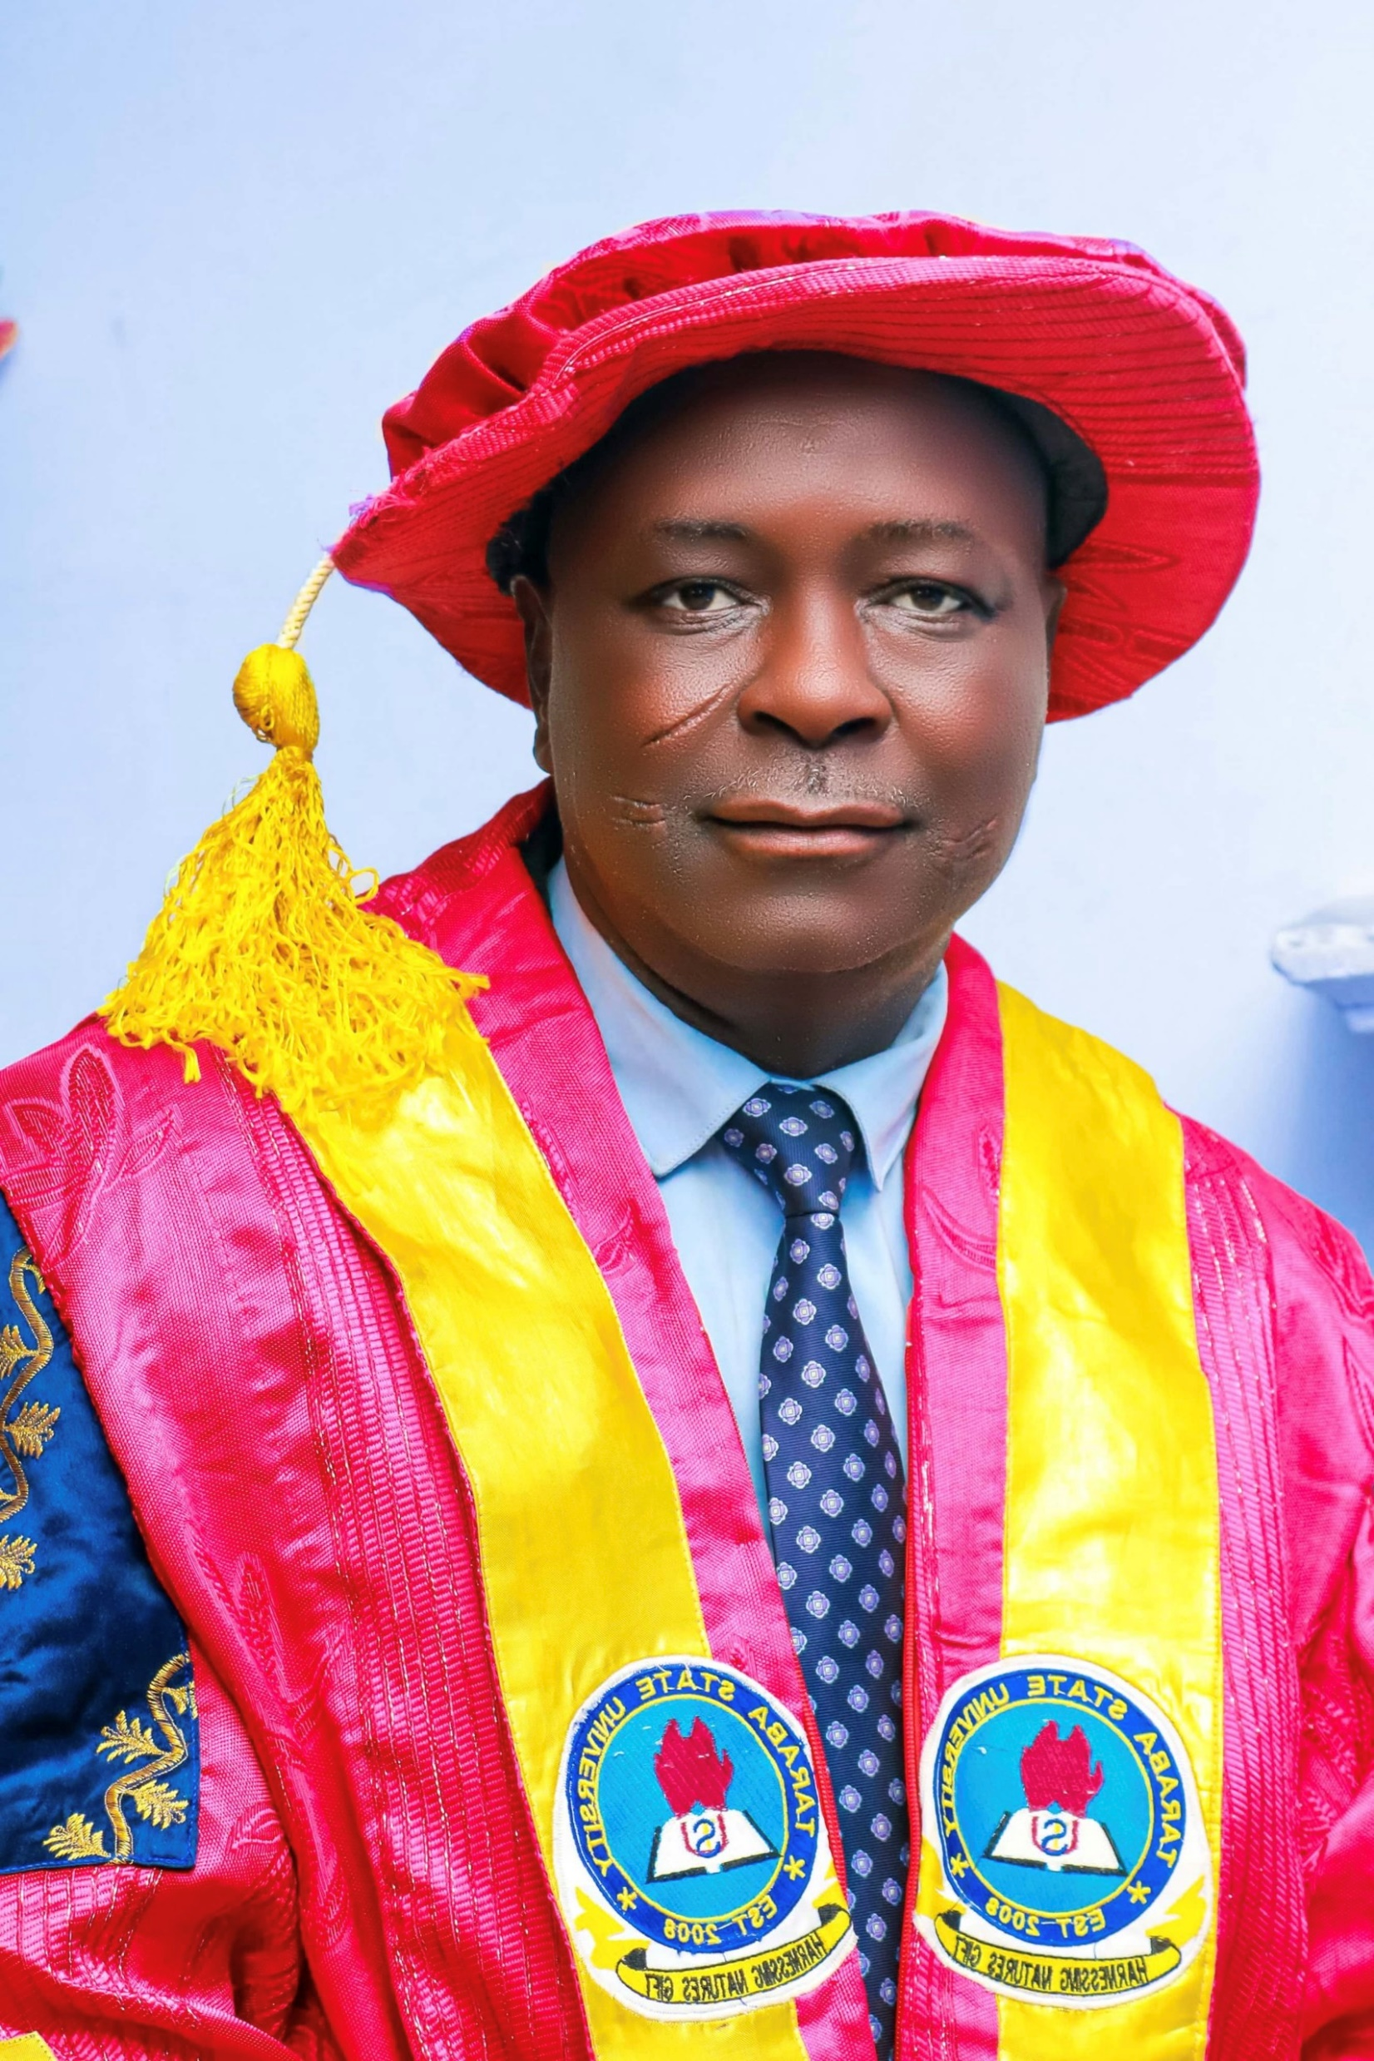
DR. ISRAEL HABIBU IDRIS
UNIVERSITY LIBRARIAN
TARABA STATE UNIVERSITY, JALIINGO.

Slide 19
DIRECTORATE TEAM

Slide 20
PROF. NAOMI NUHU ADAMU
DIRECTOR CAREER DEVELOPMENT AND EMPLOYABILITY SERVICES
TARABA STATE UNIVERSITY, JALIINGO.

Slide 21
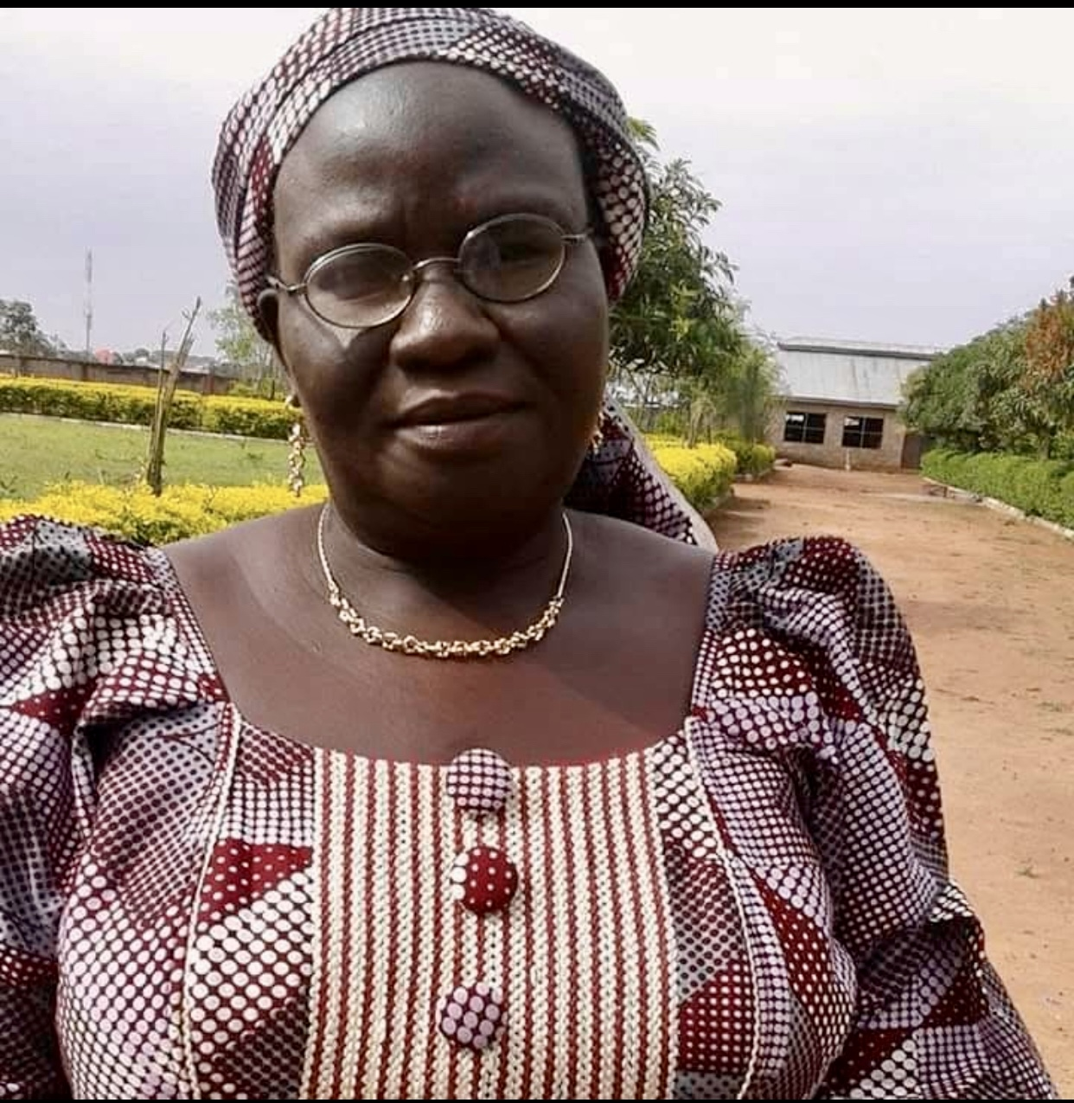
DR. ABIGAIL SETH KARFE
DEPUT DIRECTOR CAREER SERVICES
TARABA STATE UNIVERSITY, JALIINGO.

Slide 22
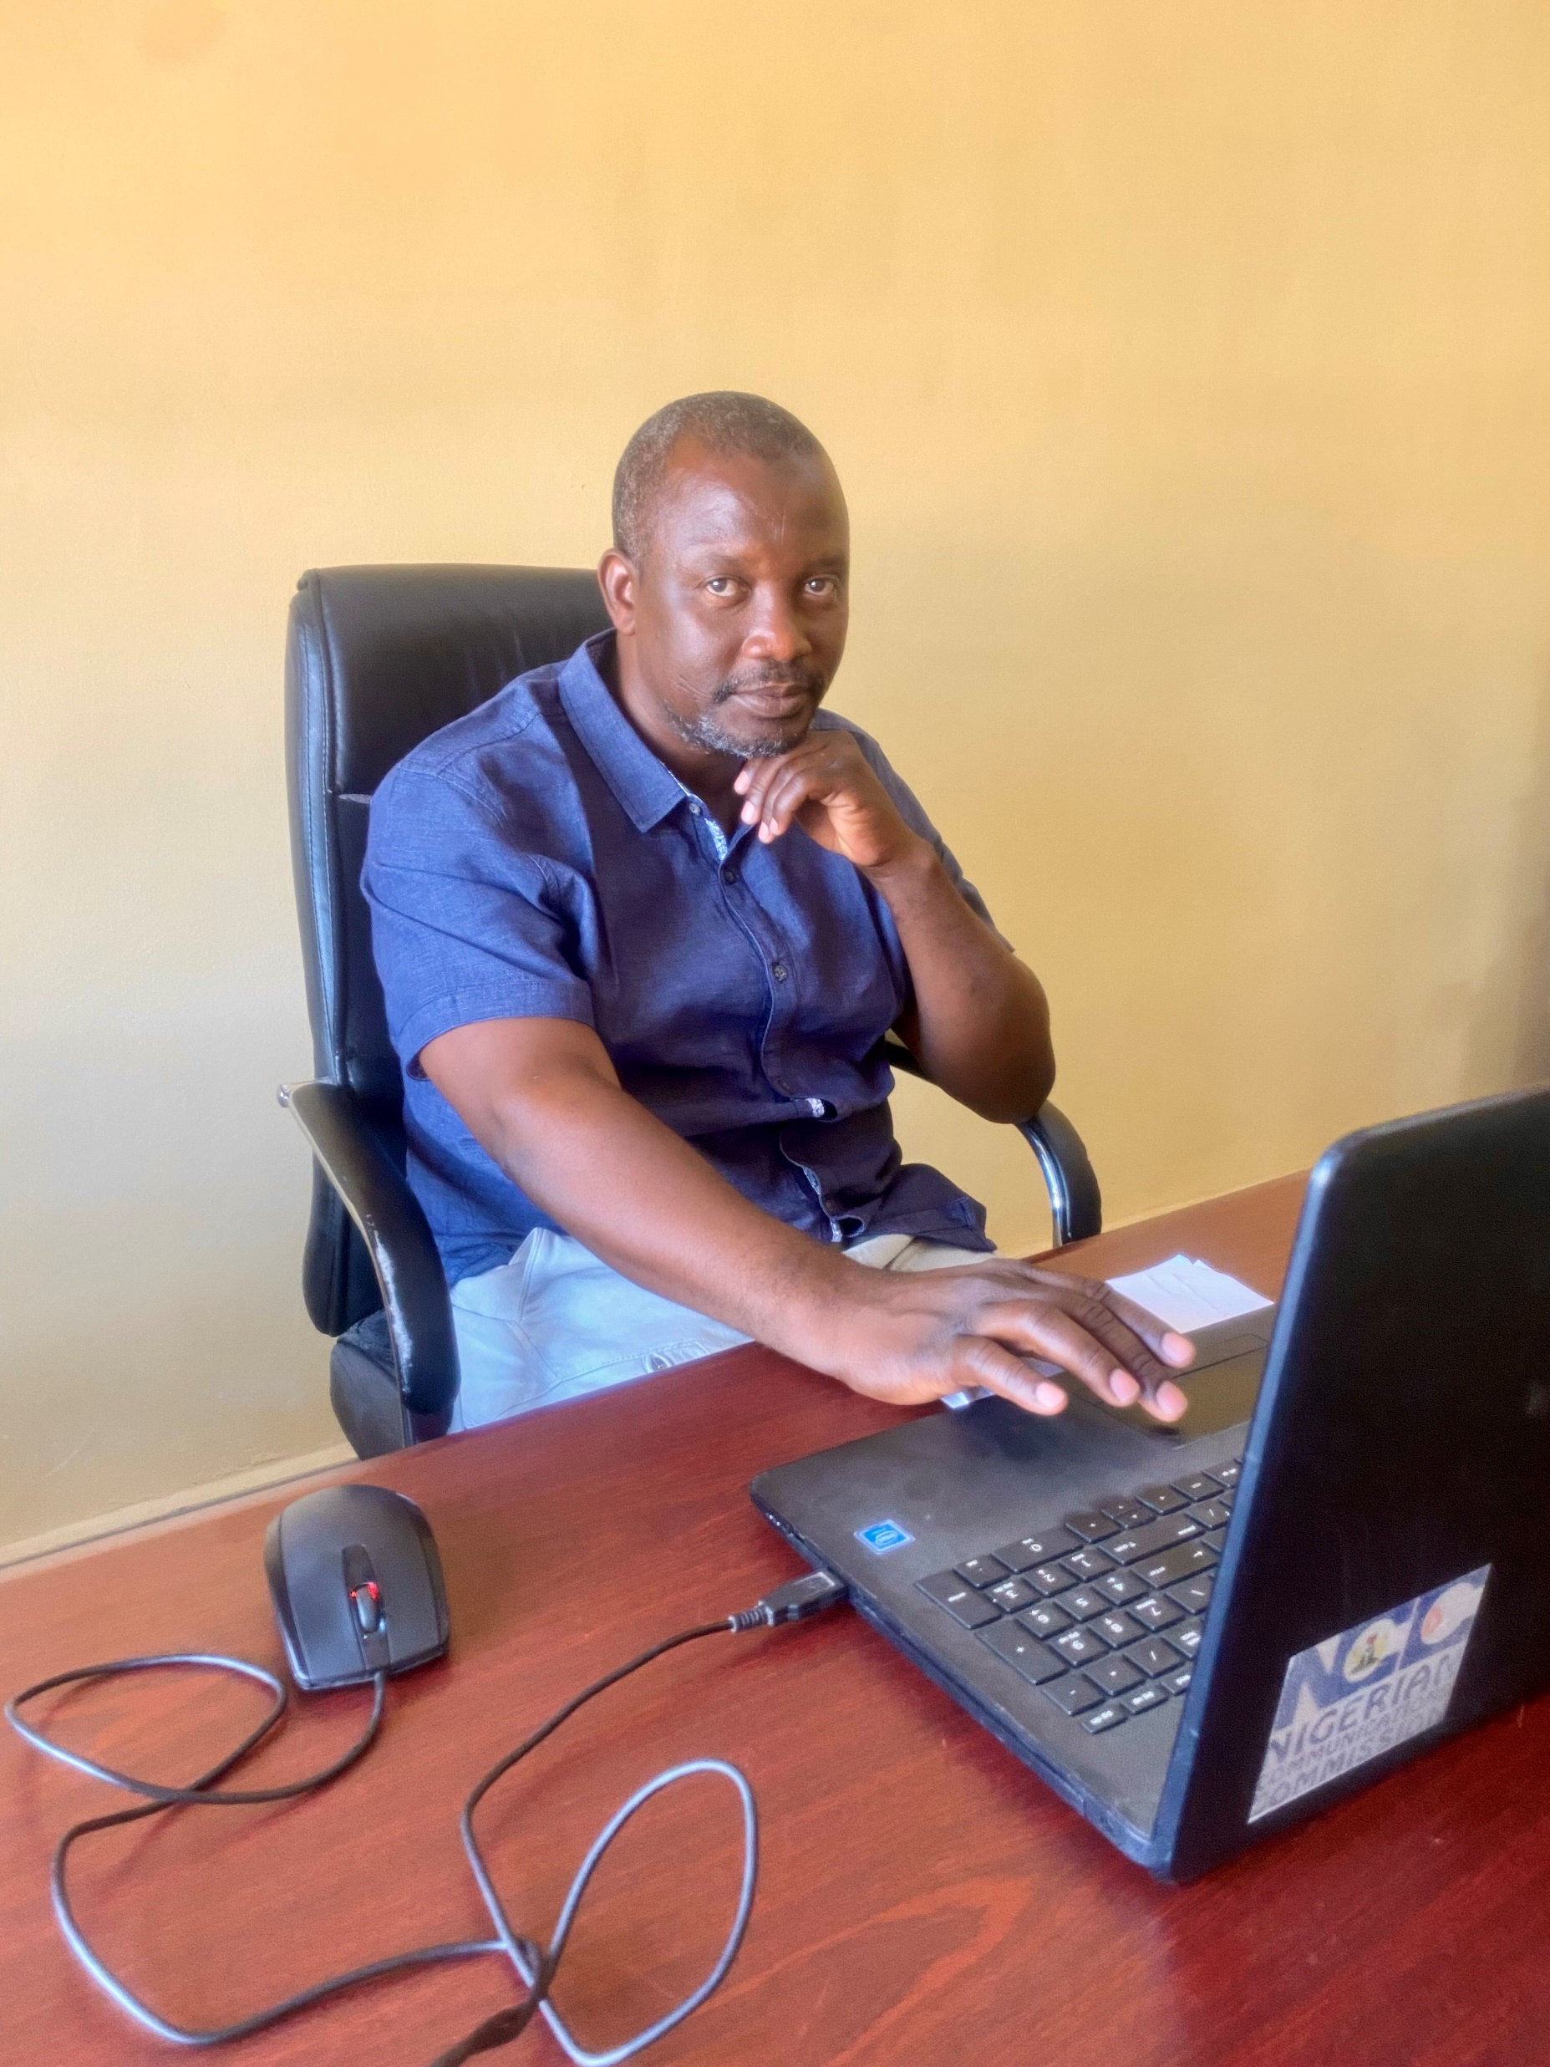
Mr. MUSA BABA
DEPUT DIRECTOR ADMIN.
TARABA STATE UNIVERSITY, JALIINGO.

Slide 23
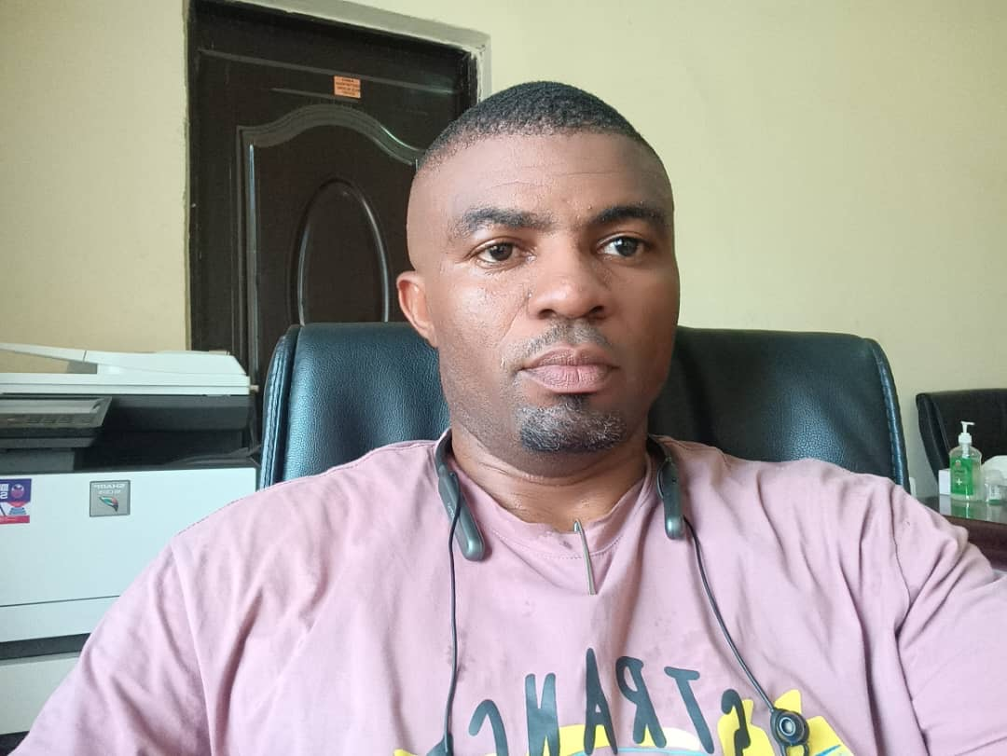
MR. CLIFFORD YUBSIH MENCHAK
COORDINATOR EMPLOYABILITY SKILLS
TARABA STATE UNIVERSITY, JALIINGO.

Slide 24
MISS. SALAMA BAKO
COORDINATOR INTERNSHIP
TARABA STATE UNIVERSITY, JALIINGO.

Slide 25
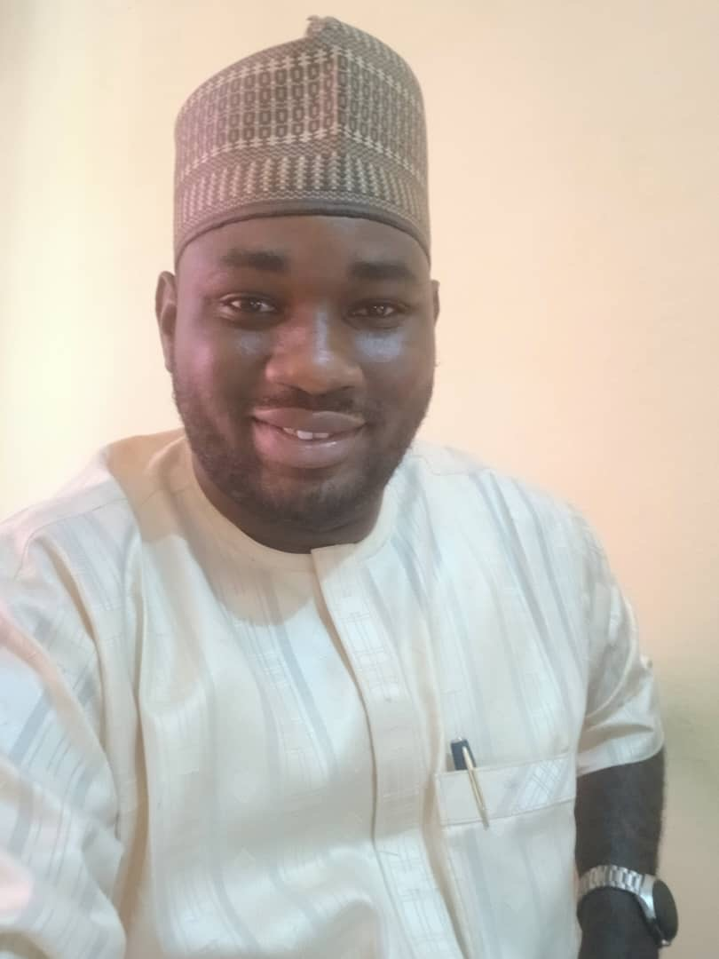
MR DAVID FRANCIS
COORDINATOR ALUMNI
TARABA STATE UNIVERSITY, JALIINGO.

Slide 26
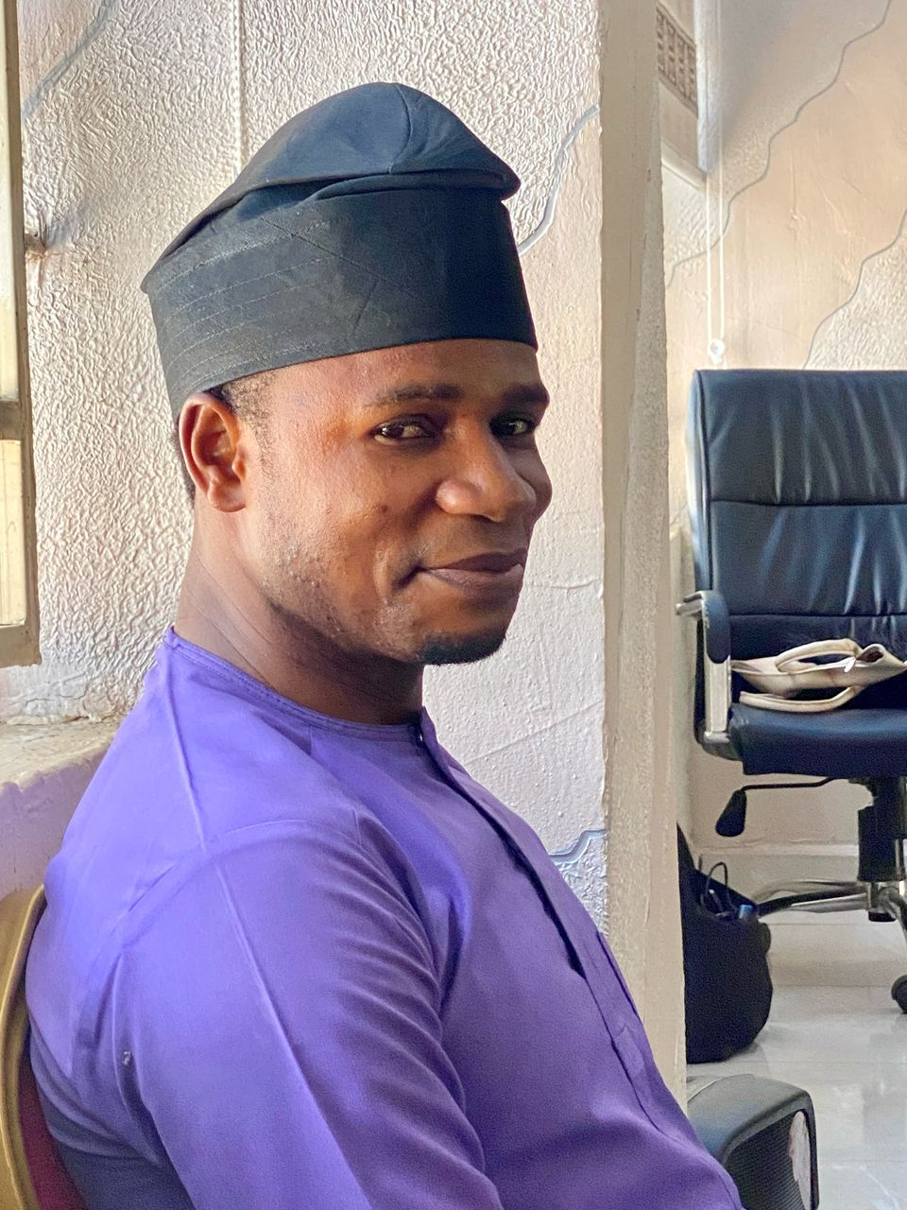
MR. LIVINUS JESSE AYIH
COORDINATOR COMMUNICATION AND MARKETING
TARABA STATE UNIVERSITY, JALIINGO.

Slide 27
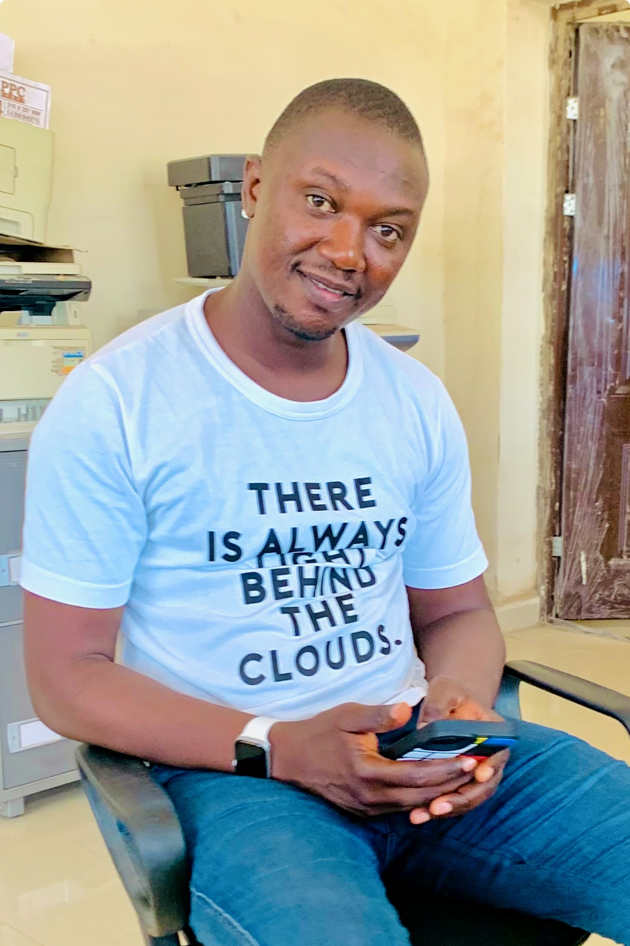
MR. JAMES MAIJANKAI JAWARA
COORDINATOR TECHNOLOGY RESOURCE SPECIALIST
TARABA STATE UNIVERSITY, JALIINGO.

Slide 28
RESOURCE PERSONS OF THE DIRECTORATE

Slide 29
PROF. AJAI T. JOHN
FACILITATOR DCDES
TARABA STATE UNIVERSITY, JALIINGO.

Slide 30
PROF. NAOMI NUHU ADAMU
FACILITATOR DCDES
TARABA STATE UNIVERSITY, JALIINGO.

Slide 31
DR. MOSES JOHN MAIKAMO
FACILITATOR DCDES
TARABA STATE UNIVERSITY, JALIINGO.

Slide 32
YOU ARE ALWAYS WELCOME TO THE DIRECTORATE.
THANK YOU

